Slide 1
Oracle APEX 24.1
New Features
Name
Presenter’s Title
Organization, Division or Business Unit
Month 00, 2024

Slide 2
Learn more at apex.oracle.com

Slide 3
What’s New in Oracle APEX 24.1?
Generative AI Support
Powerful Enterprise Components
Next-Gen Data Platform
New and Updated Components
Developer Experience
General Builder Improvements
Additional Updates and Enhancements
apex.oracle.com
Learn more at apex.oracle.com

Slide 4
Oracle APEX 24.1: What’s New?
Generative AI Support
Powerful Enterprise Components
Next-Gen Data Platform
Context-Aware GenAI for Devs
Easy AI Integration for Apps
Dynamic Data Templating
Enhanced Workflow Engine
Working Copy Compare
Vector Search
Native Server Side JavaScript
JSON Relational Duality

Slide 5
Generative AI Support

Slide 6
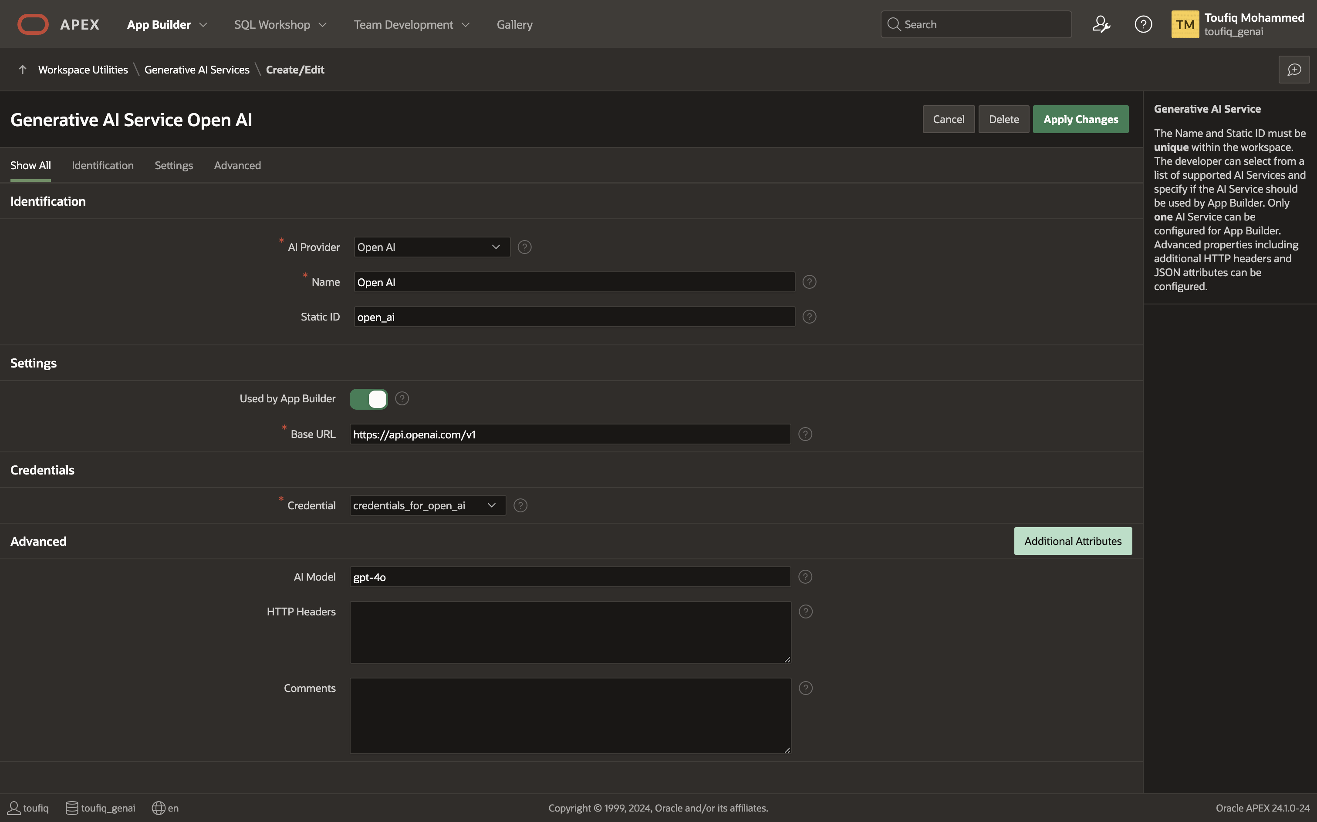
Generative AI Service
An abstraction to popular commercial Generative AI products like Open AI, Cohere and others Authenticates using Web Credentials in Oracle APEX Used by App Builder, AI Assistant & APEX_AI PL/SQL API Can be enabled/disabled on APEX Instance and Workspace levels
Learn more at apex.oracle.com

Slide 7
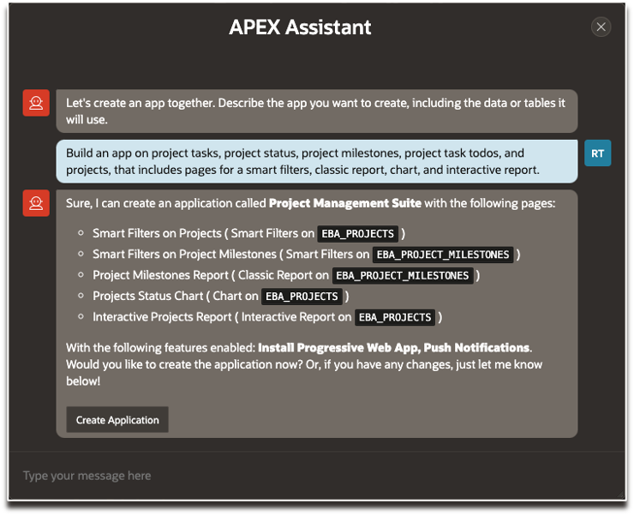
Create App from a Prompt
Generate Application Blueprint based on a Prompt
Leverages APEX Dictionary Cache to identify relevant tables
Further, enhance the generated blueprint with additional instructions
Learn more at apex.oracle.com

Slide 8
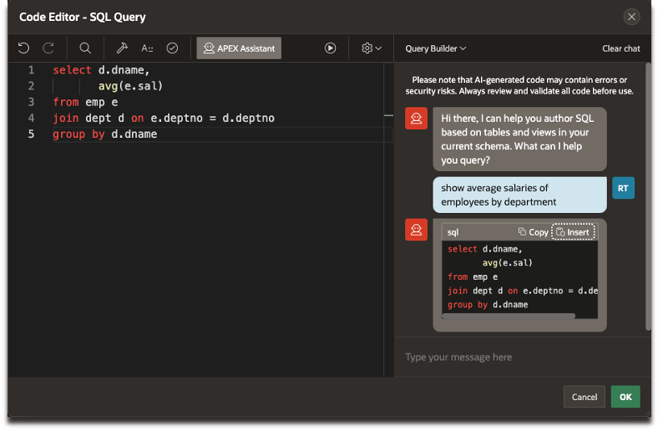
APEX Assistant in Code Editors
APEX Assistant in Code Editors leverage Generative AI Services Leverages APEX Dictionary Cache to identify relevant tables Generate SQL Queries for form and report regions using the Query Builder mode. Generate PL/SQL, JavaScript, HTML, and CSS Code using the General Assistance mode. Improve & Explain Quick Actions help improve and understand the selected code
Learn more at apex.oracle.com

Slide 9
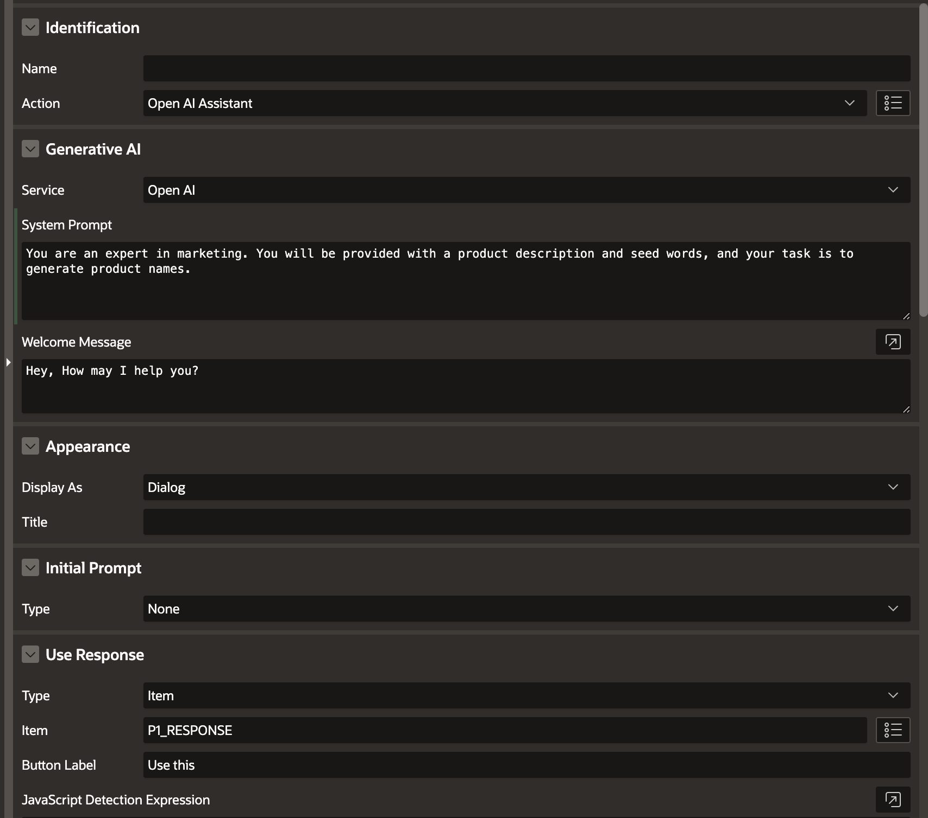
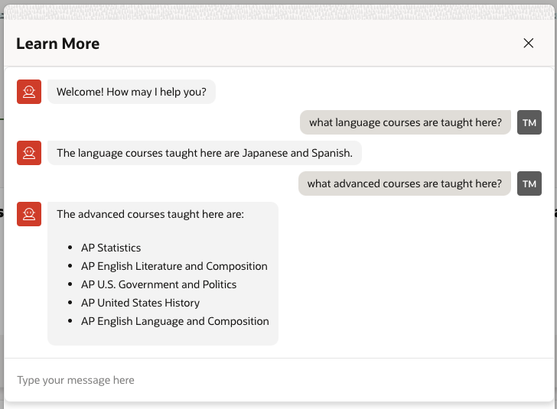
Open AI Assistant Dynamic Action
A Native Dynamic Action in Oracle APEX which opens an AI Chat User Interface
Leverages Generative AI Services configured under Workspace Utilities Rendered Inline or as a Dialog
Configurable System Prompt and Welcome Message
Learn more at apex.oracle.com

Slide 10
Next-Gen Data Platform

Slide 11
Oracle AI Vector Search - Overview
Vector Data Type and Vector Operations Natively implemented in Oracle Database
Enables searches on Business Data to be combined with Semantic Searches
Allows interactions with Large Language Models (LLMs) to be augmented with business data
Converged Database
Learn more at apex.oracle.com

Slide 12
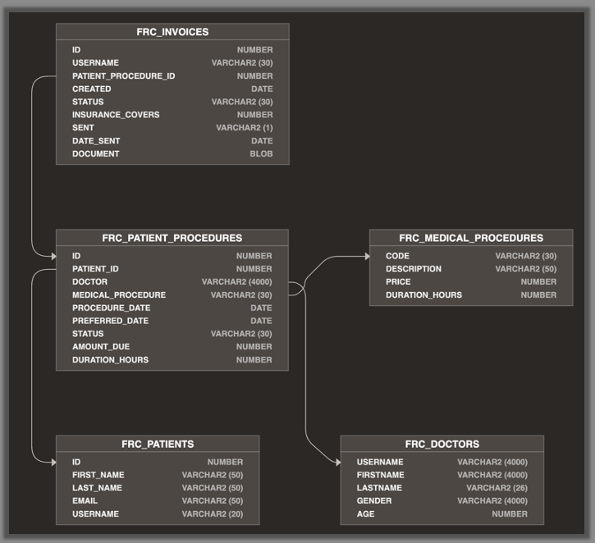
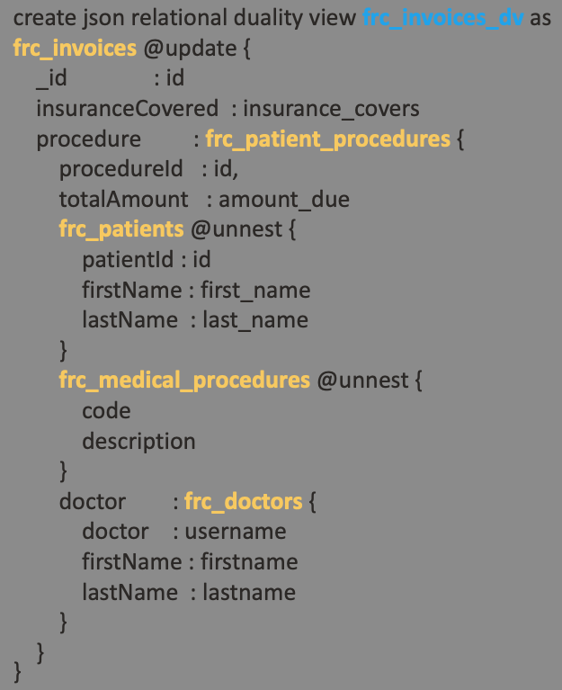
JSON Relational Duality
Leverage the power of relational and the simplicity of JSON development approaches all within a single app
By creating simple JSON Duality views on top of relational tables you can build apps that use documents to query and update the underlying data sets
APEX apps running on Oracle Database 23ai can access the same data as a set of JSON documents or as relational tables and columns without data duplication.
Converged Database
Learn more at apex.oracle.com

Slide 13
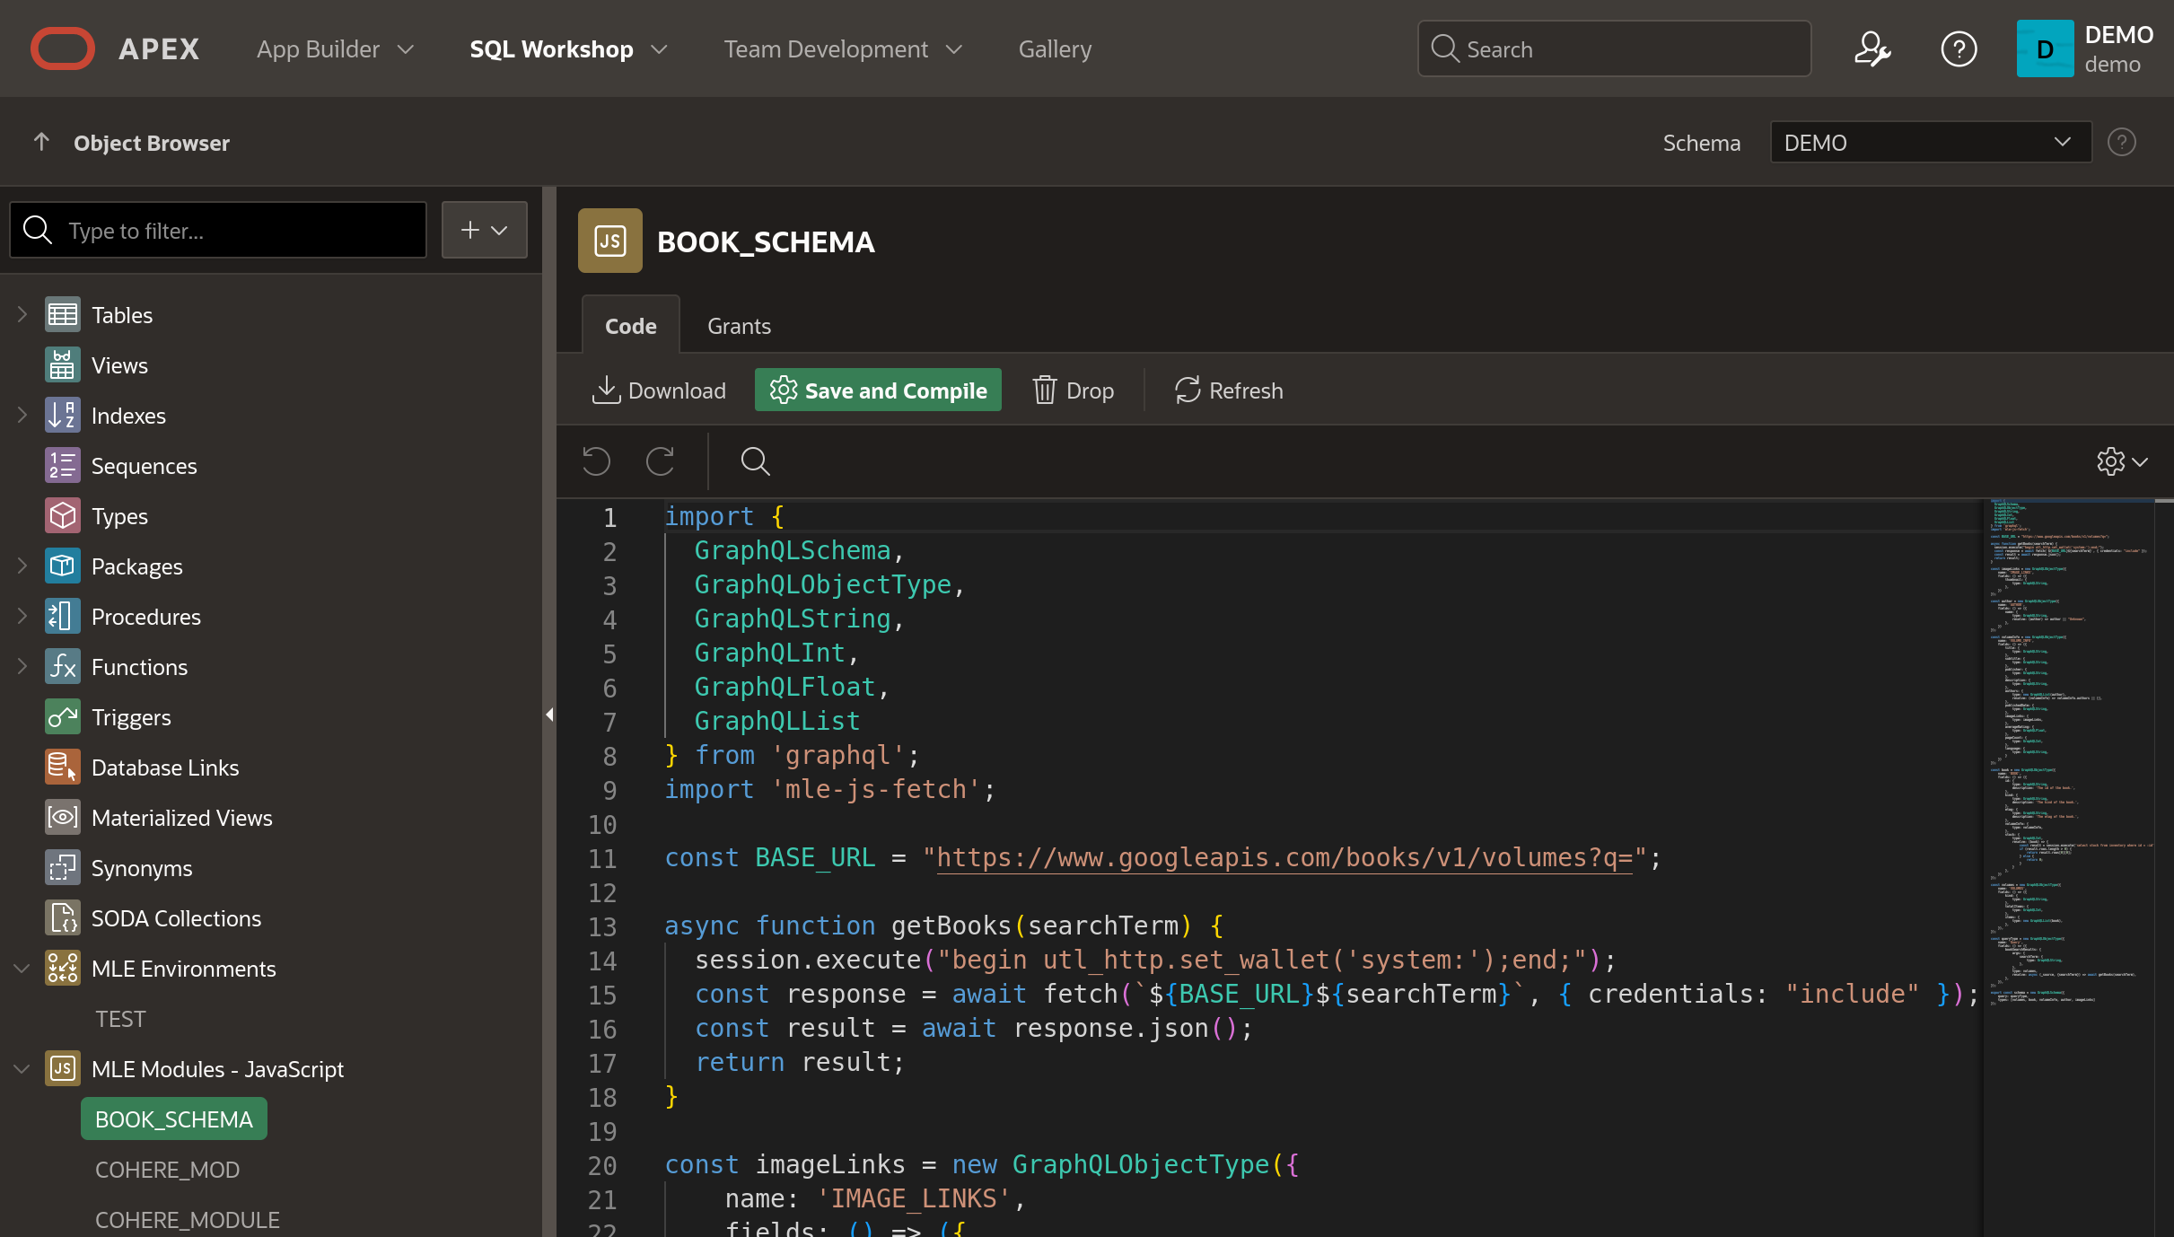
Server-Side JavaScript for Business Logic
MLE allows you to run JavaScript directly in the Oracle Database
Create JavaScript modules as schema objects that are stored persistently in the database.
Oracle APEX automatically maps the JavaScript data types to Oracle Database types.
Import and Leverage many open-source libraries from over a million JavaScript modules available online
Converged Database
Learn more at apex.oracle.com

Slide 14
Powerful Enterprise Components

Slide 15
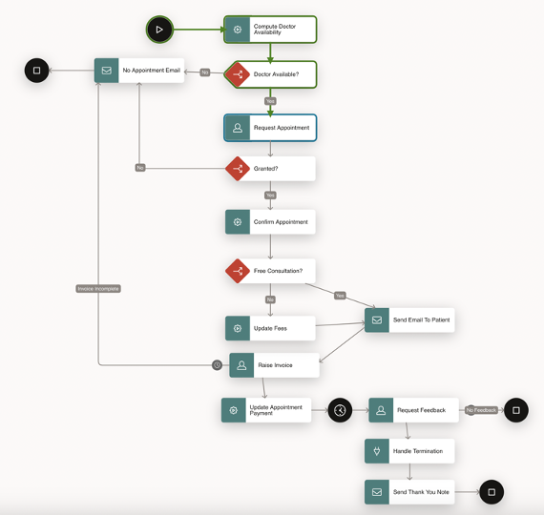
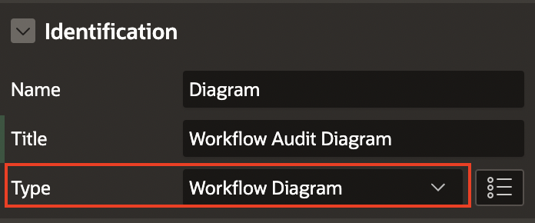
Workflow Enhancements
Workflow Diagram region displays a read-only, real-time visual representation of the workflow's progress, highlighting completed nodes and the workflow route Public APIs to fetch and handle purgeable task and workflow instances before purging. Termination Function for Asynchronous Activity Plugins New Workflow Dashboard Page Workflow Instance ID Available for Debug Messages
Learn more at apex.oracle.com
Notes:
Workflow Diagram Region
The Workflow Diagram is a new region that displays a visual representation of the currently running workflow instance. It highlights the nodes and links the instance has passed through, giving users a clear understanding of the workflow route. The region is read-only.
Archive Purge Enhancements
Public APIs to fetch the task and workflow instances that are purgeable (completed/terminated/errored).
This allows the users to retrieve the necessary data and then handle them as per their business needs prior to them getting purged
Termination Function for Asynchronous Activity Plugins
You can now specify a termination function for custom process-type plugins used as activities. The termination function executes when the workflow instance is terminated.
New Workflow Dashboards Page
When creating the Workflow Console page, you now have the option to create a Workflow Dashboards page.
The workflow dashboard page shows analytics for all workflows in a given report context, including workflows by state, active workloads, fault workloads, and average completion time of workflows.
Workflow Instance ID Available for Debug Messages
You can now expose the workflow instance ID in debug messages. This allows you to determine which workflow instance corresponds to a particular debug message.

Slide 16
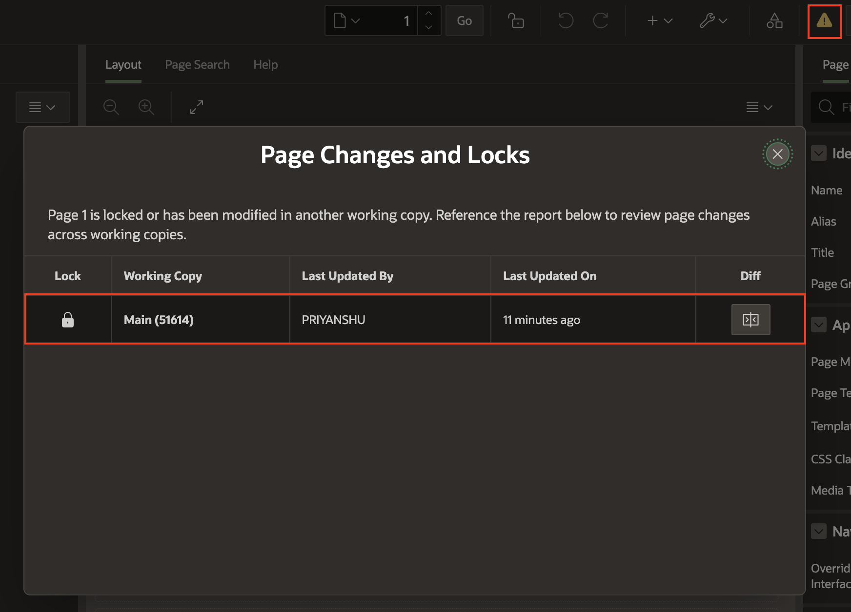
Working Copy Enhancements
Visually indicate changed and locked pages by another working copy or main Visual Indicator when you are on the main application in page designer
Compare page with the main utility
Report to see which working copies have modified or locked a page and view the differences between copies. YAML diff editor shows the last updated date to help developers identify the latest version.
Learn more at apex.oracle.com

Slide 17
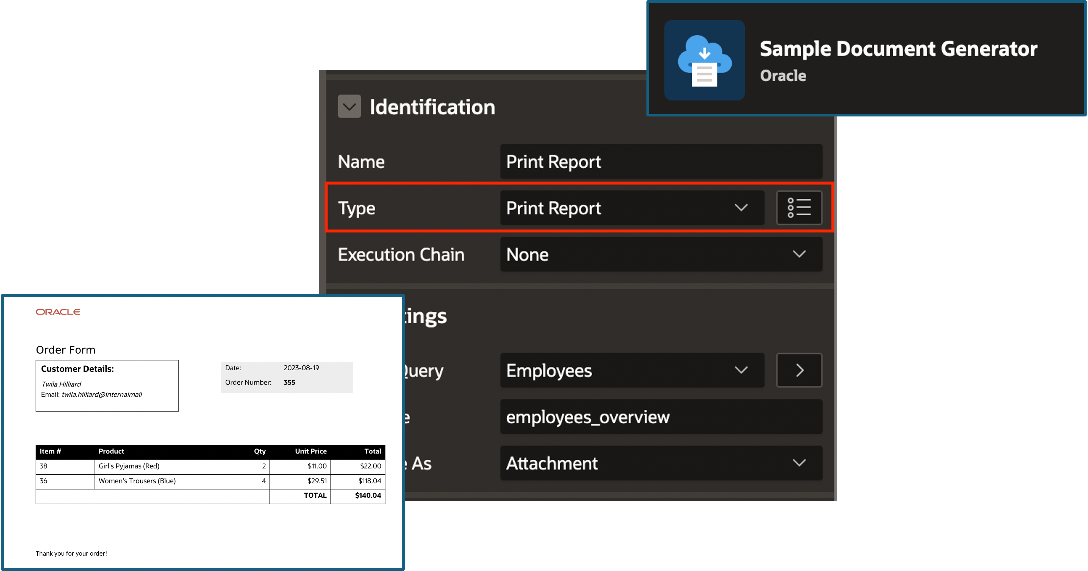
Pixel-Perfect Reports using OCI Document Generator Pre-Built Function
Leverage the OCI Document Generation Pre-Built Function to print pixel-perfect reports
Generate PDF documents from a combination of JSON data and Microsoft Word templates.
New page process type - Print Report.
Learn more at apex.oracle.com
Notes:
Declarative Selection Support for Template Component Reports
This feature enables selection support for Template Component Reports. This will enable selection (checkboxes) for Content Row.
Template Components w/o Data Source - Static Values
Ability to create a template component without an attached data source, instead provide settings for static values (could be item/value substitutions).
Slots for Template Components
Previously known as “Display Points” and later renamed to “Positions”, we are now settling on a more appropriate term: Slots.
APEX has always allowed to place regions, items and buttons inside of page positions and region positions. Now it’s Page Slots, Region Slots… and Template Component Slots!
Template component developers can define slots at the template component edit page level.
Developers can nest components inside of template components in Page Designer

Slide 18
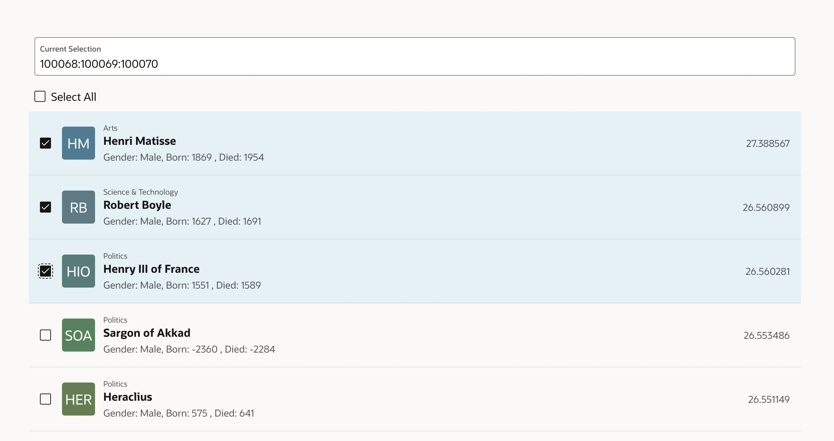
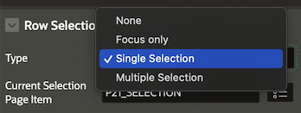
Template Components Enhancements
Declarative Selection Support for Template Component Reports
Template Components without Data Source - Static Values
Slots for Template Components
Learn more at apex.oracle.com
Notes:
Declarative Selection Support for Template Component Reports
This feature enables selection support for Template Component Reports. This will enable selection (checkboxes) for Content Row.
Template Components w/o Data Source - Static Values
Ability to create a template component without an attached data source, instead provide settings for static values (could be item/value substitutions).
Slots for Template Components
Previously known as “Display Points” and later renamed to “Positions”, we are now settling on a more appropriate term: Slots.
APEX has always allowed to place regions, items and buttons inside of page positions and region positions. Now it’s Page Slots, Region Slots… and Template Component Slots!
Template component developers can define slots at the template component edit page level.
Developers can nest components inside of template components in Page Designer

Slide 19
New and Updated Components

Slide 20
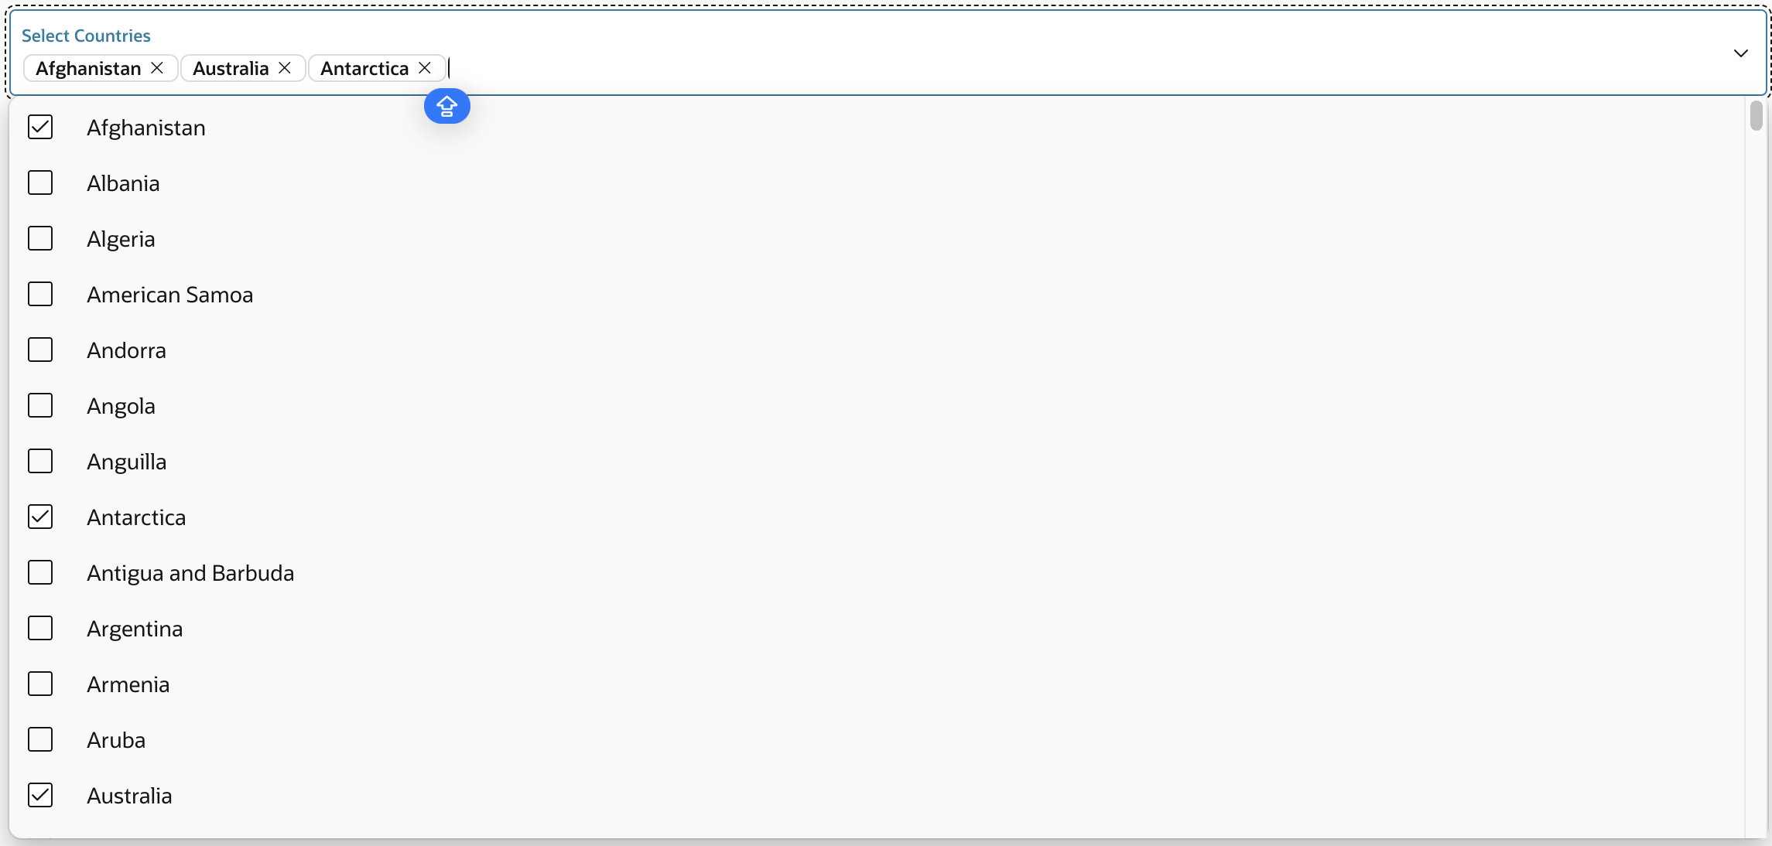
New Select One and Select-Many Item Types
An LOV based item, that allows only entries included on the data set, like a select list.
Support includes:
Custom HTML for the choices with Template Directives
Icons
Groups
JSON Session State
Multi-column search, and displaying
Multi-select, user can select more than one option, and the dropdown remains open.
Show chips as delimited list, when the focus is not on the Select Many item
Learn more at apex.oracle.com
Notes:
Declarative Selection Support for Template Component Reports
This feature enables selection support for Template Component Reports. This will enable selection (checkboxes) for Content Row.
Template Components w/o Data Source - Static Values
Ability to create a template component without an attached data source, instead provide settings for static values (could be item/value substitutions).
Slots for Template Components
Previously known as “Display Points” and later renamed to “Positions”, we are now settling on a more appropriate term: Slots.
APEX has always allowed to place regions, items and buttons inside of page positions and region positions. Now it’s Page Slots, Region Slots… and Template Component Slots!
Template component developers can define slots at the template component edit page level.
Developers can nest components inside of template components in Page Designer

Slide 21
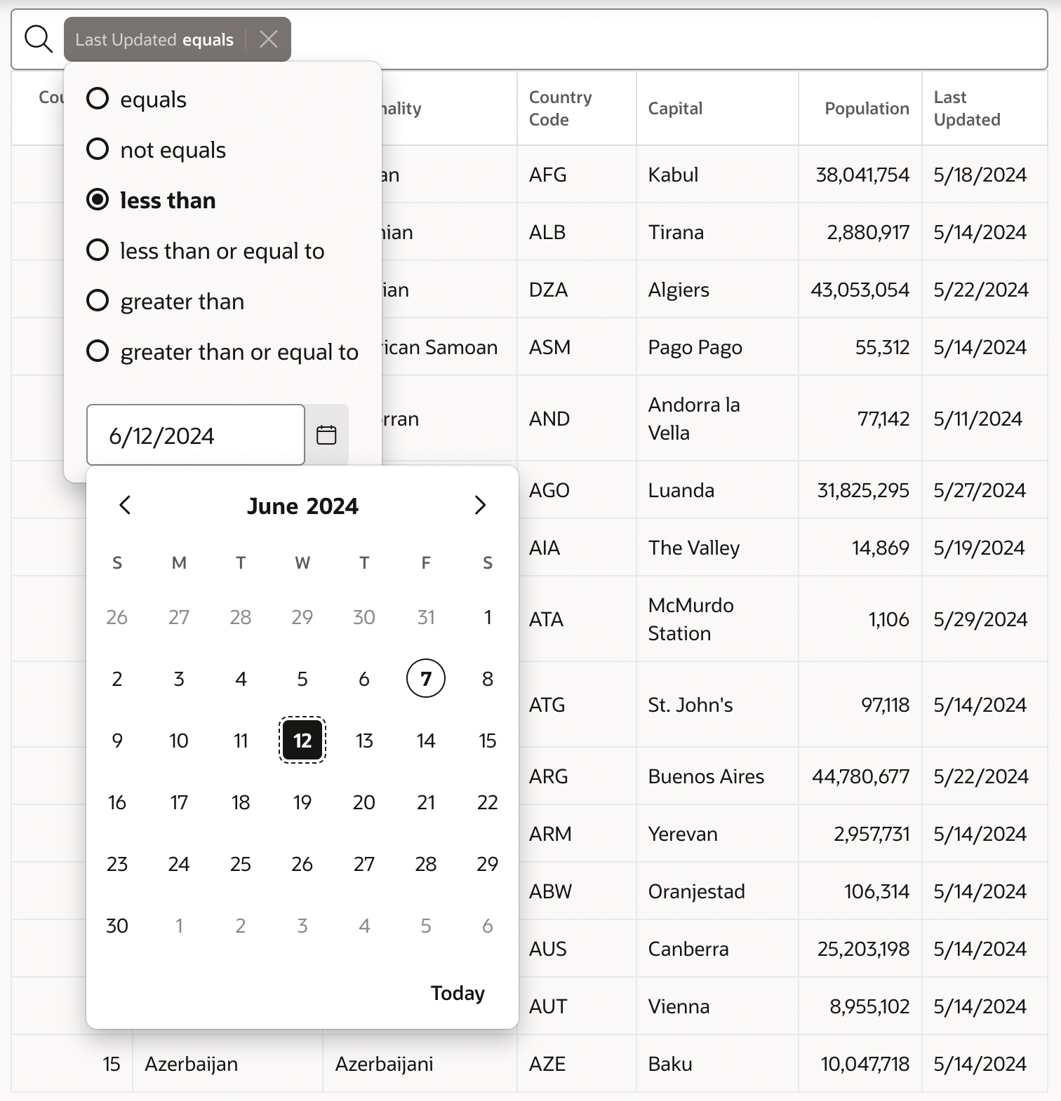
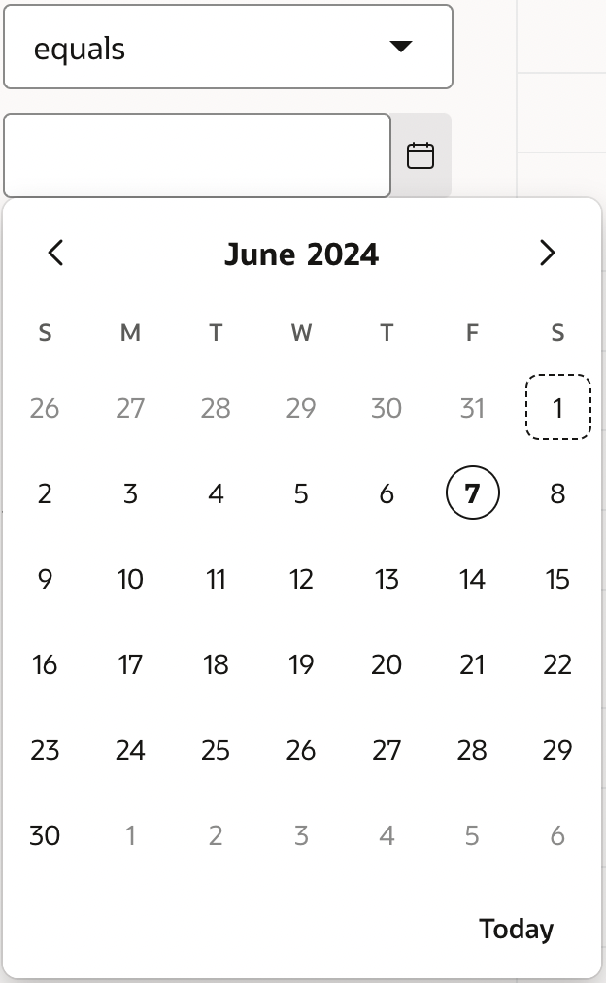
Date Picker Support in Faceted Search and Smart Filters
Date Picker support for Input Facets and Manual Range Inputs on Faceted Search and Smart Filters Regions.
You can set/use your own format mask for date representation.
Learn more at apex.oracle.com
Notes:
Declarative Selection Support for Template Component Reports
This feature enables selection support for Template Component Reports. This will enable selection (checkboxes) for Content Row.
Template Components w/o Data Source - Static Values
Ability to create a template component without an attached data source, instead provide settings for static values (could be item/value substitutions).
Slots for Template Components
Previously known as “Display Points” and later renamed to “Positions”, we are now settling on a more appropriate term: Slots.
APEX has always allowed to place regions, items and buttons inside of page positions and region positions. Now it’s Page Slots, Region Slots… and Template Component Slots!
Template component developers can define slots at the template component edit page level.
Developers can nest components inside of template components in Page Designer

Slide 22
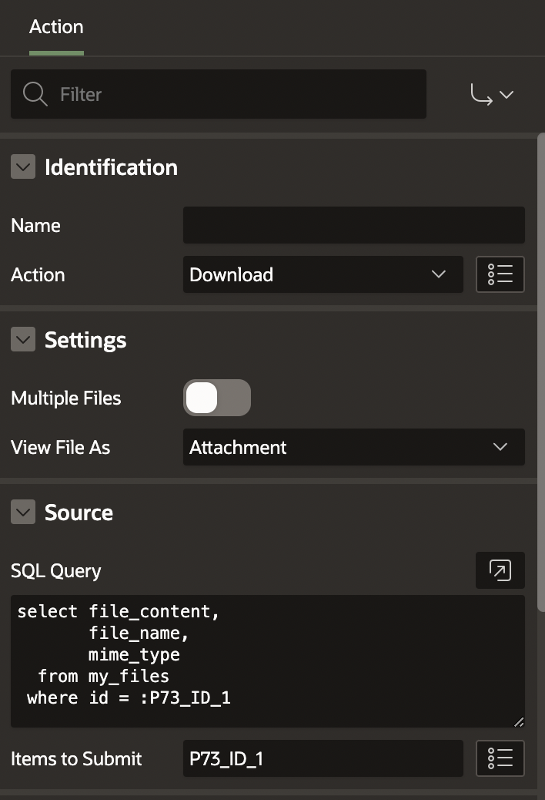
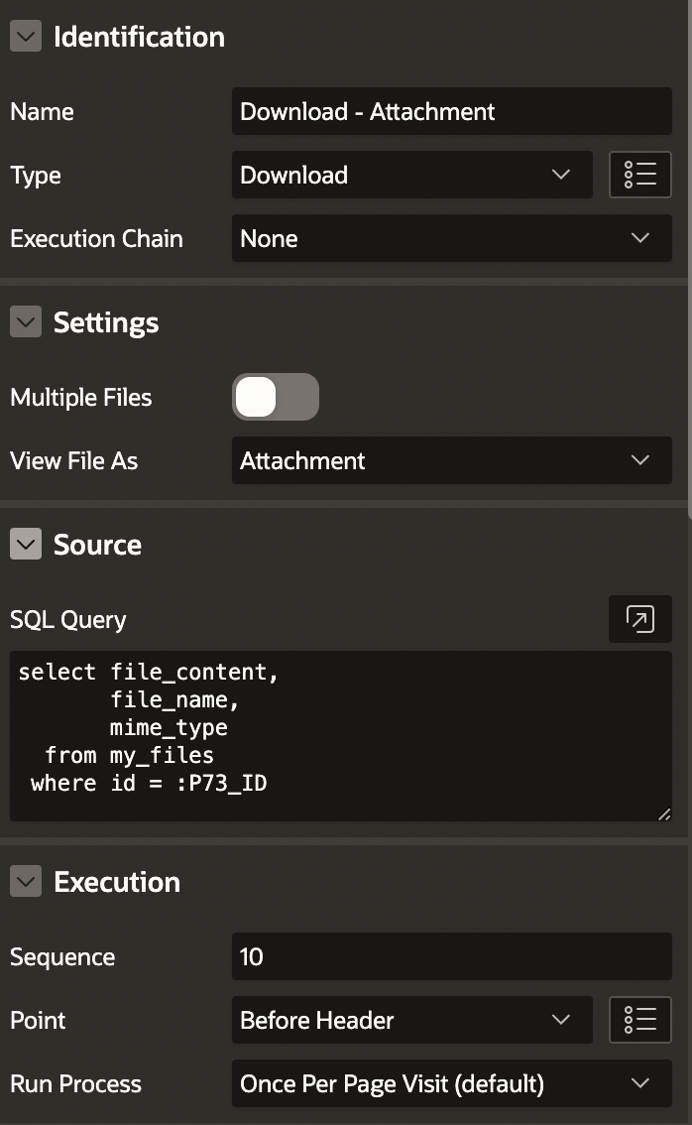
Declarative BLOB/CLOB File Download Support
New “Download” Dynamic Action
New “Download” Process Type
Download multiple files as a zip archive
Support CLOB/VARCHAR2 data types as file content
Show file as attachment (download) or inline (inside browser)
Learn more at apex.oracle.com
Notes:
Declarative Selection Support for Template Component Reports
This feature enables selection support for Template Component Reports. This will enable selection (checkboxes) for Content Row.
Template Components w/o Data Source - Static Values
Ability to create a template component without an attached data source, instead provide settings for static values (could be item/value substitutions).
Slots for Template Components
Previously known as “Display Points” and later renamed to “Positions”, we are now settling on a more appropriate term: Slots.
APEX has always allowed to place regions, items and buttons inside of page positions and region positions. Now it’s Page Slots, Region Slots… and Template Component Slots!
Template component developers can define slots at the template component edit page level.
Developers can nest components inside of template components in Page Designer

Slide 23
Server Side Geocoding
A new process type, Server Side Geocoding, is available on Oracle APEX Autonomous Database instances.
This allows users to turn a postal address to a coordinate on the server independently from the UI.
Server Side Geocoding is supported for Page Processes, Automation Actions, Task Definition Actions, and Workflow Activities
Learn more at apex.oracle.com

Slide 24
Multi-Domain Support for SAML Authentication
APEX now supports the "AssertionConsumerServiceIndex" attribute in SAML authentications.
Administrators can configure SAML callbacks for multiple domains.
See Supported Callback URLs in the Instance Administration settings under Security, SAML Authentication, or Configuring SAML Sign-In in Oracle APEX Administration Guide.
Dynamic Action Enhancements
New 'Input' Dynamic Actions Event
The browser event Input is now available when configuring a Dynamic Action. The event is fired every time the value of the element changes. This is different from the Change event, which only fires when the value is committed--for example, by pressing the Enter key or selecting a value from a list of options.
The Input event is not fired when JavaScript changes an element's value programmatically.
New Quick Pick options for Dynamic Actions
Execute JavaScript Code and Execute Server-side Code are now available from the Quick Pick options.
Learn more at apex.oracle.com

Slide 25
Improvements to REST Source Infrastructure
Introduction support for hierarchical REST Source Data Profiles. The features at a glance are:
Introduce "Array Columns" in REST Data Source Data Profiles, which allow to model the JSON hierarchy of a REST Data Source.
APEX Components can now consume data from REST Sources on every hierarchy level.
APEX is no longer limited to REST APIs returning "flat" JSON responses.
Array Columns and Hierarchies supported in REST Source Catalog as well.
Full support in APEX_EXEC PL/SQL API: build DML requests with Array columns, and programmatically fetch hierarchical data from REST Sources
New REST Source parameter type Parent Column allows to pass the value of a Parent IG in a Master Detail relationship to the REST Source.
New "Is Common" Data Profile Column attribute. This allows our Create Page wizards to focus on the important attributes when creating new pages.
Copyright © 2024, Oracle and/or its affiliates
Learn more at apex.oracle.com

Slide 26
Support for Database Credentials
Web credentials can now reference a database credential to store the Client ID and Client Secret. The web credential type must be Basic Authentication or OAuth2 Client Credentials. This feature is only available on Oracle Database 23ai or Autonomous Database release 19c or later.
The database credential is completely maintained by the database, and APEX does not have access to the stored secrets
Web Credentials of the Basic and OAuth type can now use a Database Credential to store the secret.
Use DBMS_CREDENTIAL or DBMS_CLOUD packages to create such a credential.
Configured at the Web Credential level. Components like REST Sources, APEX_WEB_SERVICE or REST Enabled SQL are unchanged.
Copyright © 2024, Oracle and/or its affiliates
Learn more at apex.oracle.com

Slide 27
Developer Experience

Slide 28
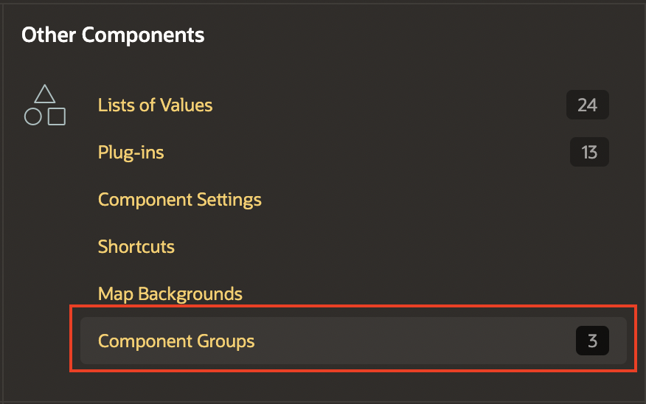
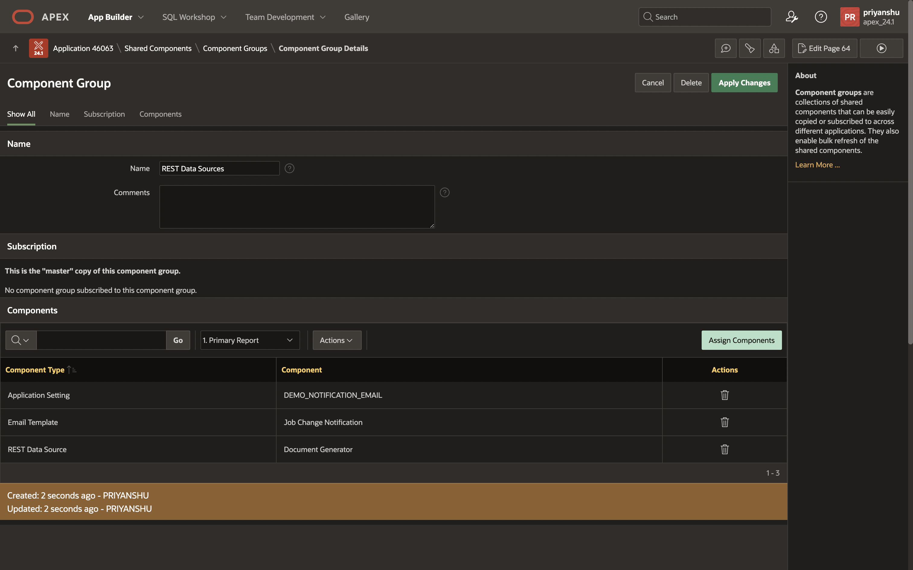
Component Groups
A new shared component, Component Groups. It is a collection of other shared components.
Allows you to easily copy, subscribe to, or refresh all components in the group with a single action.
All the shared components that support subscription can be added to a component group
Learn more at apex.oracle.com
Notes:
Declarative Selection Support for Template Component Reports
This feature enables selection support for Template Component Reports. This will enable selection (checkboxes) for Content Row.
Template Components w/o Data Source - Static Values
Ability to create a template component without an attached data source, instead provide settings for static values (could be item/value substitutions).
Slots for Template Components
Previously known as “Display Points” and later renamed to “Positions”, we are now settling on a more appropriate term: Slots.
APEX has always allowed to place regions, items and buttons inside of page positions and region positions. Now it’s Page Slots, Region Slots… and Template Component Slots!
Template component developers can define slots at the template component edit page level.
Developers can nest components inside of template components in Page Designer

Slide 29
Improved Shared Components Subscriptions
APEX 23.2 added new subscription features to shared components, including setting subscribed components as read-only, automatic dependency resolution, a subscription status column, and bulk refresh or deletion of subscriptions.
Starting APEX 24.1, these features are now available on the following components:
Lists
Data Load Definitions
REST Data Source
Authentication Scheme
Authorization Scheme
List of Values
Plug-ins
Shortcuts
Search Configurations
Learn more at apex.oracle.com

Slide 30
Multi-Value Item Type Support and Custom Separators Support
The Shuttle, Select Many, Select List, Combo box, List Manager, and Popup LOV support a custom separator character for delimited list string values or a JSON array value. Plug-in developers can add the same functionality to their own multivalued item plug-ins.
New Custom Separator support for the Shuttle, Select List, Combo box, List Manager, and Popup LOV item types.
Provides a generic solution to handle developer-defined separators for multi-value-based items, to prevent individual item implementations.
Built-in Oracle TEXT Search functions
APEX_SEARCH is now extended with two Oracle Text Query functions, Search Engine and Expert Search. These functions enable advanced full text search features including fuzzy searching and proximity search. You can access these functions programmatically with APEX_SEARCH.QUERY_SEARCH_ENGINE and APEX_SEARCH.QUERY_EXPERT_SEARCH.
Learn more at apex.oracle.com

Slide 31
Readable Export Enhancements
Application Export has a readable/diffable version in YAML format. With APEX 24.1, we have extended this support to include:
Export Individual Page in Readable Format
Pages can now be exported in readable YAML format through the Export Page option in App Builder, or through sqlcl/command line. You can use this method to compare different versions of a page in a readable format.
Improvements for better diff analysis
Exporting in readable format will default "Original IDs" to Yes.
Application level readable export-only export by setting 'Readable Format' switch to on.
Include Audit Information in Readable exports
This feature will allow developers to optionally include audit information in export files. Audit information options include None, Names and Dates, Dates Only.
Learn more at apex.oracle.com

Slide 32
General Builder Improvements

Slide 33
Builder Extensions Enhancements
This feature enables APEX applications installed in a workspace, that is configured to host “Extensions”, to be invoked and used from other workspaces on the same instance. The Extension application, if read-access is granted by the invoking workspace, to access the application meta-data (views) of that invoking workspace. Feature overview:
New Builder Extension Sign-in Authentication Scheme, which enables opening the Extension app from a Builder session without having to sign-in with username/password
Publish Extension apps using the Extension Menu
Workspaces can subscribe to Extension Menus from Extension Workspaces and invoke the Extensions published
New API, that allows accessing repository data of workspaces, that have granted read access, to an Extension workspace in Automations or PL/SQL in APEX session context.
Learn more at apex.oracle.com

Slide 34
Page Designer Improvements
Resizable icon picker modal dialog, for better usability.
New Name Attribute for Regions - similar to pages, regions now support both Name and Title attributes.
Copy this Page' menu option - renamed menu option from 'Page as Copy', to be more intuitive, and streamlined the copy page wizard, by reducing the number of wizard steps.
New 'Show Processing' attribute added to page buttons when 'Submit Page' action is selected. This will help prevent users from double-clicking, and submitting the page twice.
New 'Alternative Label' attribute for Interactive Report columns, to use in dialogs and in various column heading placements. Use an alternative label when the heading contains extra formatting such as HTML tags.
New Template Option to hide empty values on Classic reports using templates "Value Attribute Pairs - Column" and "Contextual Info".
Learn more at apex.oracle.com

Slide 35
App Builder Enhancements
Spotlight Search Enhancements
Search results are shown in categories; Results have their search term highlighted.
Component Export/Import with Offsets
To add support for importing and exporting components with offsets, in the development environment. With previous releases, this is only possible to do this on the command line.
New process type "Server Side Geocoding"
This feature introduces a new process type "Server Side Geocoding" to APEX ADB instances. This will allow users to perform server-side geocoding (turning a postal address to a coordinate) independently from the UI as well as automating their geocoding processes using Automations.
Learn more at apex.oracle.com

Slide 36
Additional Updates & Enhancements

Slide 37
Translation of Runtime Messages into Ukrainian and Vietnamese
APEX now supports the translation of runtime messages into Ukrainian and Vietnamese, extending our language support to 34 languages.
APEX supports the following languages: Arabic, Brazilian Portuguese, Croatian, Czech, Danish, Dutch, Finnish, French, French - Canada, German, Greek, Hebrew, Hungarian, Icelandic, Italian, Japanese, Korean, Norwegian, Polish, Portuguese (Portugal) (pt), Romanian, Russian, Serbian - Cyrillic, Serbian - Latin, Simplified Chinese, Slovak, Slovenian, Spanish, Swedish, Thai, Traditional Chinese, Turkish, Ukrainian, and Vietnamese.
Universal Theme Updates
Improved Content-Security-Policy for Universal Theme
Redwood Light Enhancements
Minor UI enhancements for Avatars, Badges, Combobox & LOV chips, File Drop Train (Wizard), Input focus styles, IG & IRR filter/chips and Page header
Learn more at apex.oracle.com

Slide 38
Accessibility Improvements
Improved read-only item state
This feature introduces changes to support accessible rendering of read-only items.
New APIs added, and the following native item types use it: Color Picker, Combobox, Date Picker, Number, Display Only, Popup LOV, Select List, Select One, Select Many, Switch Text, Textfield, Text with Autocomplete, and Textarea
Accessibility-focused help text
There are many attributes that are very important for accessibility. To simplify the process and emphasize the significance of these attributes, new accessibility-specific help text has been added to these attributes in Page Designer, aiming to better guide developers into creating accessible APEX apps.
Continuing from the work done in APEX 23.2 improving the development environment user experience for all users, APEX 24.1 further improves the developer experience when building APEX apps.
Numerous other accessibility-focused bug fixes.
Learn more at apex.oracle.com

Slide 39
PL/SQL API Updates
APEX_APP_OBJECT_DEPENDENCY
Analyse APEX applications and report all references to database objects by page and application using this new PL/SQL API.
Allow APEX developers to have an overview, and run analysis, on all database objects their uses within each application.
Report all used database objects by an application like tables, packages, procedures, functions, etc.
For example, find all occurrences where a column of a table or view is used throughout an application.
APEX_AUTOMATION
New TERMINATE function to terminate a currently executing automation, and now deprecating an existing function, ABORT.
APEX_EXEC
New DESCRIBE_QUERY function to describe columns and data types of a data source (Local, REST Source or REST Enabled SQL).
Learn more at apex.oracle.com

Slide 40
PL/SQL API Updates
APEX_INSTANCE_ADMIN
New EXPIRE_FND_USER_ACCOUNTS, MAX_LOGIN_FAILURES, and ACCOUNT_LIFETIME_DAYS parameters added to the list for use with SET_WORKSPACE_PARAMETER and GET_WORKSPACE_PARAMETER, to control account locking on runtime-only instances.
New p_grant_apex_privileges parameter added to the ADD_SCHEMA procedure, when add a workspace schema.
New CREATE_OR_UPDATE_ADMIN_USER procedure signature 2, accepting one parameter, p_username. Create an instance administration user account (i.e. a user in the INTERNAL workspace). If the account already exists, unlock it. This creates or updates the account with a random password, which is not needed when the builder authentication is Database Accounts.
APEX_PLUGIN_UTIL
New PRINT_READ_ONLY API that handles the rendering of read-only items. This new API should be used instead of the existing apex_plug_util.print_display_only.
Learn more at apex.oracle.com

Slide 41
JavaScript Library Upgrades
Oracle JET 16.0.1
FullCalendar 6.1.11
Monaco Editor 0.47.0
MarkedJS 12.0.1
Less.js 4.2.0
DOMPurify 3.1.2
Terser 5.30.3
Map Region: Upgrade Mapbox to MapLibre 4.0.1
TinyMCE 6.8.3
PrismJS 1.29.0
csso 5.0.5
cropperjs 1.6.1
Turndown 7.1.3
Font APEX 2.3
Oracle Rich Text Library
Learn more at apex.oracle.com

Slide 42
Oracle APEX Training and Certification
Learn more at apex.oracle.com

Slide 43
Oracle APEX Training & Certification
apex.oracle.com/go/training
APEX Foundations
apex.oracle.com/go/foundations
APEX Developer Professional
apex.oracle.com/go/professional
Get Certified
apex.oracle.com/go/professional
Empowering Low Code Apps with AI
apex.oracle.com/go/ai-learn
Learn more at apex.oracle.com

Slide 44
Learn the Fundamentals of Oracle APEX
Oracle APEX Foundations Course
Learn the fundamentals of low-code app dev with Oracle APEX
3.5 + hour expert training delivered by the APEX Product Team
Enroll and learn for FREE Today on Oracle University!! apex.oracle.com/go/foundations
Available on LinkedIn Learning
www.linkedin.com/learning/oracle-apex-foundations
Don't forget to share your badge on social media and tag us using #orclAPEX
Learn more at apex.oracle.com

Slide 45
Become an Oracle APEX Professional
Oracle APEX Developer Professional Course
Soup-to-nuts covering complete low-code app dev with Oracle APEX
13 hours of expert training delivered by the APEX Product Team
Hands-on-Labs to practice along with the training videos
Enroll and learn for FREE Today on Oracle University!! apex.oracle.com/go/professional
Learn more at apex.oracle.com

Slide 46
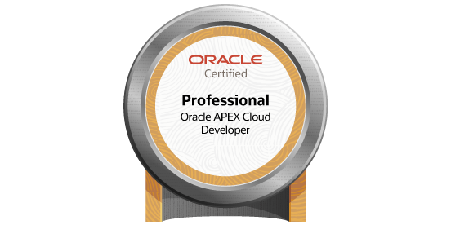
Get Oracle APEX Certified
apex.oracle.com/go/professional
Become an Oracle APEX Cloud Developer Certified Professional:
Complete Oracle APEX Developer Professional course
Perform Oracle APEX Developer Professional Hands-on-Labs
Prepare for Oracle APEX Cloud Developer Professional Exam
Register and pass the Oracle APEX Cloud Developer Professional online certification exam
Learn more at apex.oracle.com

Slide 47
Empowering Low Code Apps with AI
Learn the latest advancements of AI in Oracle APEX
Hands-on-Labs to practice along with the training videos
Earn APEX + AI Champion Badge on completion
APEX + AI Champion
Don't forget to share your badge on social media and tag us using #orclAPEX
Enroll and learn for FREE Today on Oracle University!! https://apex.oracle.com/go/ai-learn
Learn more at apex.oracle.com

Slide 48
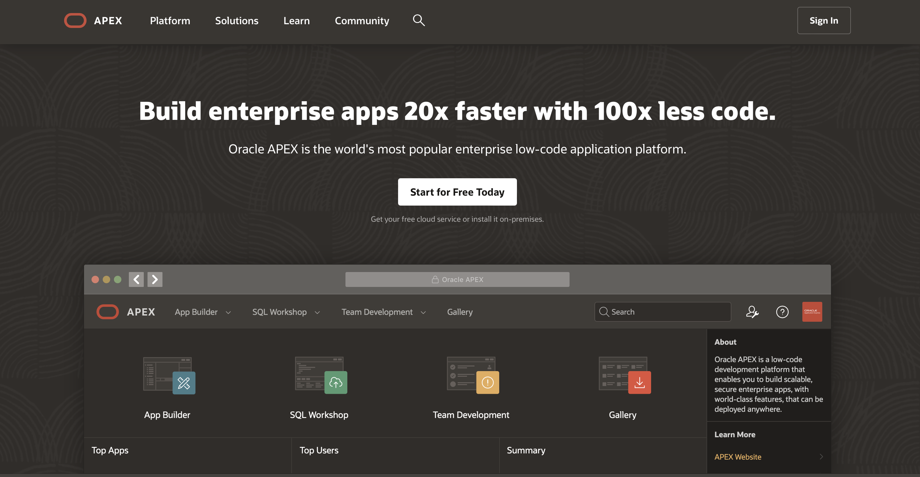
Everything about Oracle APEX
apex.oracle.com
Learn more at apex.oracle.com

Slide 49
Thank you

